Slide 1
Crash Course
By: Daniel Chelling

Slide 2
Motivation
Wanting to analyze if there are any correlations between car accidents
Determine what affects severity of car crashes
Which Variables are the most important in car crashes

Slide 3
Overview of Dataset
Dataset was found on Kaggle.com
https://www.kaggle.com/sobhanmoosavi/us-accidents
Large Dataset
56 variables
Specific Variables used in testing
Severity
City
State
County
Weather

Slide 4
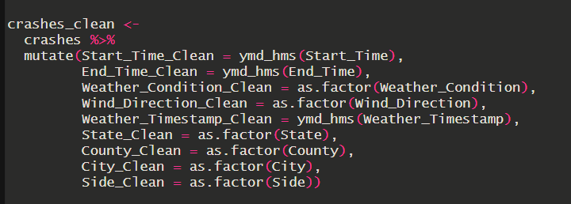
Data Cleaning
Data needed cleaning specifically in the time area.

Slide 5
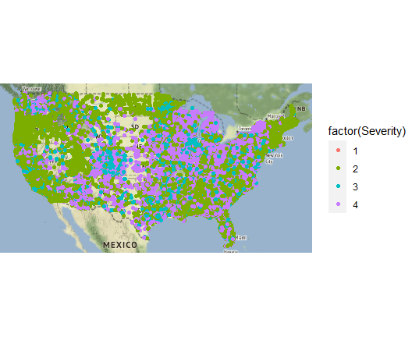
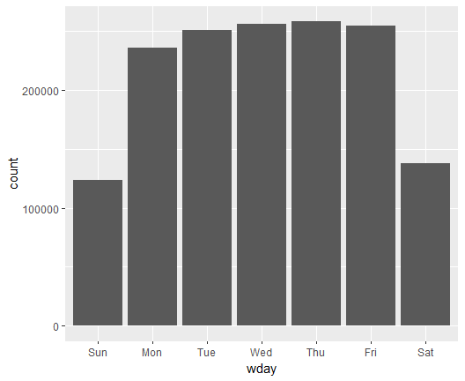
Data Visualization

Slide 6
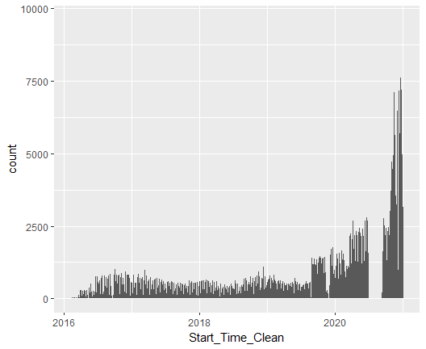
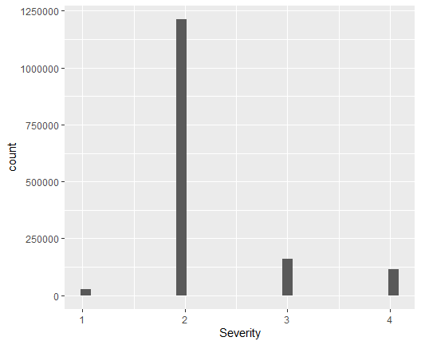
Data Visualization

Slide 7
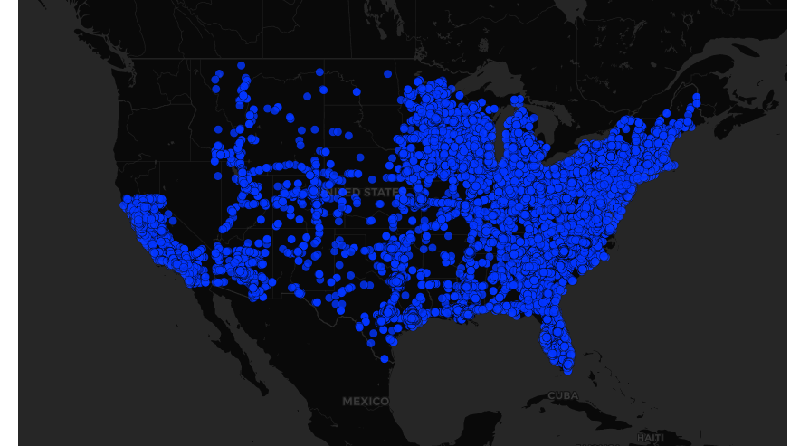
Data Visualization: R-Shiny
Interactive Map Visualizing all the Data

Slide 8
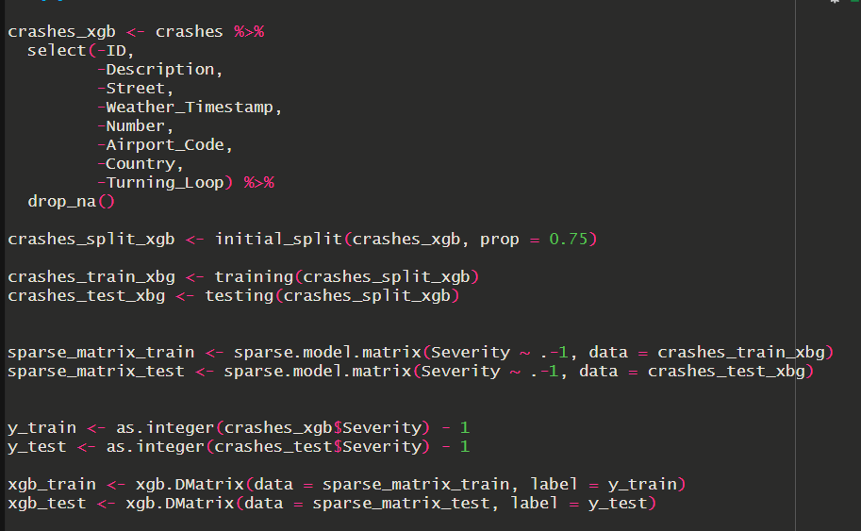
Gradient Boosting
Extra Data Cleaning Needed
Turn Data into matrix
Turn all variables into numeric
Split into train and test matrixes

Slide 9
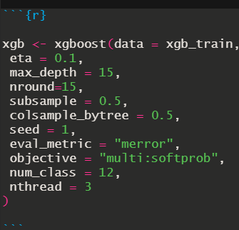
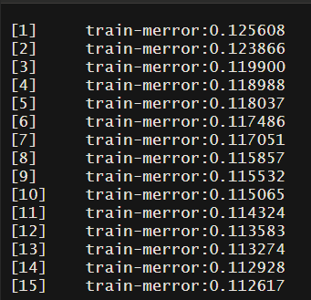
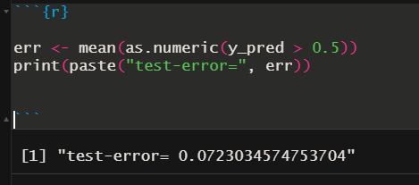
Gradient Boosting
15 iterations
Train Error throughout training
Average Error is 0.0723

Slide 10
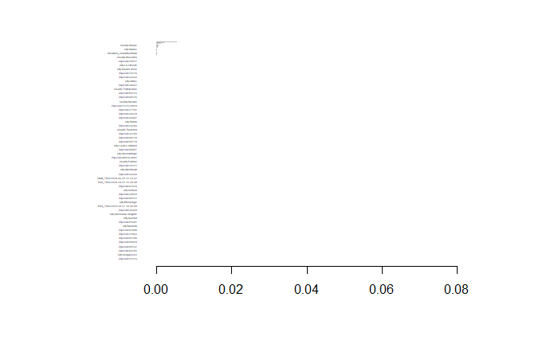
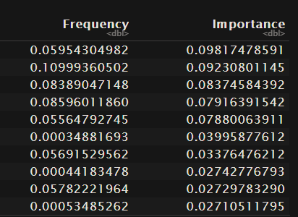
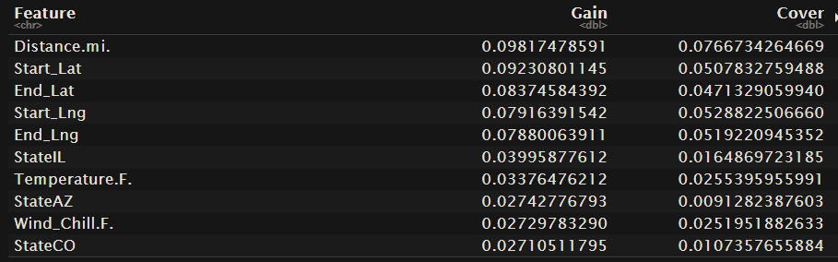
Importance Matrix

Slide 11

Real World Implications
Knowledge on Traffic Flow and risk of Crashes
Knowledge on Severity of Crashes and what affects them
Information for Safety Precautions Cities and business can use

Slide 12
Thank you!
Github Link:
https://github.com/DChells/MGSC-310-Project

